Slide 1

Workshop Team-04
Topic - IMPALA

Slide 2




Team members :
Bhavani Pathuri Nithya Vudayamarri Manasa Goriparthi Chitraleka Chikku

Slide 3
Contents:
Introduction
Architecture of Impala
Benefits of Impala
Difference between Hive & Impala
Demo

Slide 4
Impala Introduction
Massively parallel processing (MPP) SQL (Pronounce as Sequel) query execution engine that runs on the Hadoop platform.
Analysts and data scientists use Impala to analyze Hadoop data via SQL or other business intelligence tools.
1
Bhavani Pathuri

Slide 5
Continued…!
The Impala architecture also enhances SQL query speed on Hadoop data. The fast turnaround of Impala queries enables new categories of solutions.
Impala introduces high flexibility to the familiar database Extract, Transform, and Load process. You can access data with a combination of different Impala and Hadoop components without duplicating or converting the data.
Bhavani Pathuri
2

Slide 6
Using Impala
The data arrives in Hadoop after fewer steps, and Impala queries it immediately.
The high-capacity and high-speed storage system of a Hadoop cluster let you bring in all the data. As Impala can query raw data files, you can skip the time-consuming steps of loading and reorganizing data. This provides new possibilities for querying analytic data.
You can use exploratory data analysis and data discovery techniques to query this type of data.
3
Bhavani Pathuri

Slide 7
Impala Core Components
Impala daemon
Impala State Store
Impala Metadata and Metastore
Manasa Goriparthi
4

Slide 8
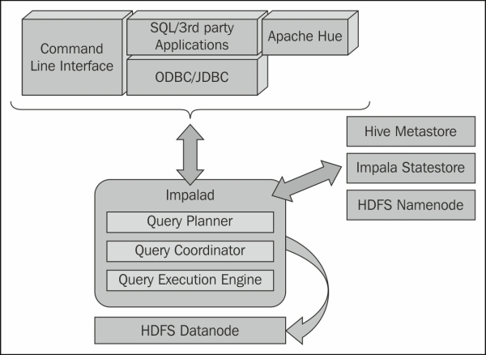
Reference : https://subscription.packtpub.com/book/big_data_and_business_intelligence/9781783281275/1/ch01lvl1sec15/impala-core-components
Manasa Goriparthi

Slide 9
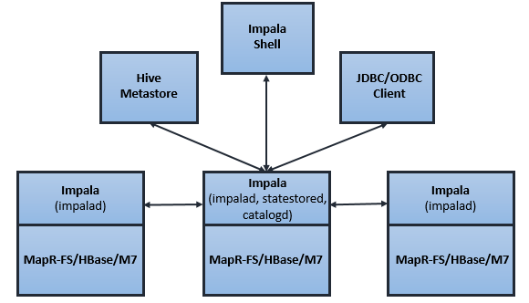
Impala daemon
Reference : https://mapr.com/docs/52/Impala/Impala.html
Manasa Goriparthi
6

Slide 10
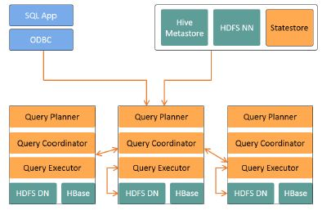
Impala Statestore
Reference : https://www.simplilearn.com/working-with-impala-tutorial-video
7
Manasa Goriparti

Slide 11
Impala Metadata and Metastore
Impala tracks information about file metadata, that is, the physical location of the blocks about data files in HDFS.
When dealing with an extremely large amount of data, getting table specific metadata could take a significant amount of time. So a locally stored metadata cache helps in providing such information instantly.
8
Manasa Goriparthi

Slide 12
Benefits of impala
Familiar SQL interface that data scientists and analysts already aware of.
Ability to interactively query data on big data in Apache Hadoop.
Distributed queries in a cluster environment,for convenient scaling and to make use of cost-effective commodity hardware.
Single system for big data processing and Analytics,so customers can avoid costly modeling and ETL just for analytics.
Nithya Vudayamarri
9

Slide 13
Continued...
Ability to share data files between different components with no copy or export/import step; for example, to write with Pig and read with Impala, or to write Impala and read with Hive.This is the best about Impala
Nithya Vudayamarri
10

Slide 14
Impala vs Hive
Impala is SQL on HDFS while hive is SQL on Hadoop.
Impala uses MPP engine to distribute the query processing while Hive uses Map Reduce.
No MR overhead in case of Impala while Hadoop, since use MR, has the overhead attached.
Impala is not fault tolerant while Hive has the usual fault tolerance of Map Reduce.
Nithya Vudayamarri
11

Slide 15
Continued…!
Map Reduce materializes all intermediate results,which enables better scalability and fault tolerance. Impala streams intermediate results between executors.
Impala is recommended for real time SQL queries while Hive is recommended for large batch jobs.
Hive generates query expressions at compile time whereas Impala does runtime code generation for “big loops”.
12
Nithya Vudayamarri
Notes:
fault tolerance( while slowing slowing down data processing). Impala streams intermediate results between executors( trading off scalability).

Slide 16
DEMO
13
Chitralekha Chikku

Slide 17
References:
https://www.tutorialspoint.com/impala/index.htm
https://www.tutorialspoint.com/impala/impala_shell.htm
14

Slide 18


Slide 19


